Slide 1
Orbit Propagation to Determine Satellite’s Demise
Jacob Bailey
Gus Lee
Michael Lesnewski

Slide 2

Introduction
Background:
The Chinese space station Tiangong 1 re-entered the Earth’s atmosphere and fell to its demise on April 2, 2018 over the South Pacific Ocean at 24.5°S 151.1°W.
Project Objective:
Propagate the orbit of the Tiangong 1 space station and estimate the lifetime of the space station using both numerical integration of the perturbed Keplarian equations of motion and the averaged Gauss’ variational equations.
Source: https://news.sky.com/story/chinese-space-lab-tiangong-1-re-enters-earths-atmosphere-11313548

Slide 3
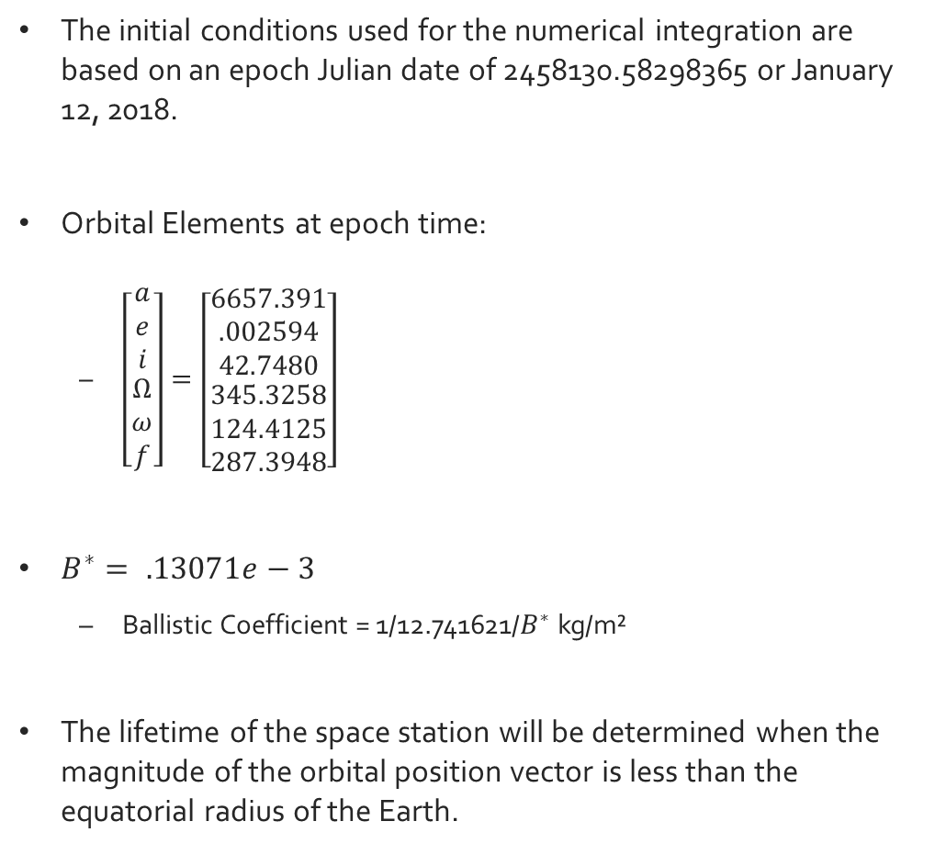
Initial Conditions for Orbit Propagation
The initial conditions used for the numerical integration are based on an epoch Julian date of 2458130.58298365 or January 12, 2018.
Orbital Elements at epoch time:
$\left[\begin{matrix}\begin{matrix}a \\ e \\ i\end{matrix} \\ \begin{matrix}Ω \\ ω \\ f\end{matrix}\end{matrix}\right]=\left[\begin{matrix}\begin{matrix}6657.391 \\ .002594 \\ 42.7480\end{matrix} \\ \begin{matrix}345.3258 \\ 124.4125 \\ 287.3948\end{matrix}\end{matrix}\right]$
$B^{∗}= .13071e−3$
Ballistic Coefficient = 1/12.741621/$B^{∗}$ kg/m²
The lifetime of the space station will be determined when the magnitude of the orbital position vector is less than the equatorial radius of the Earth.

Slide 4
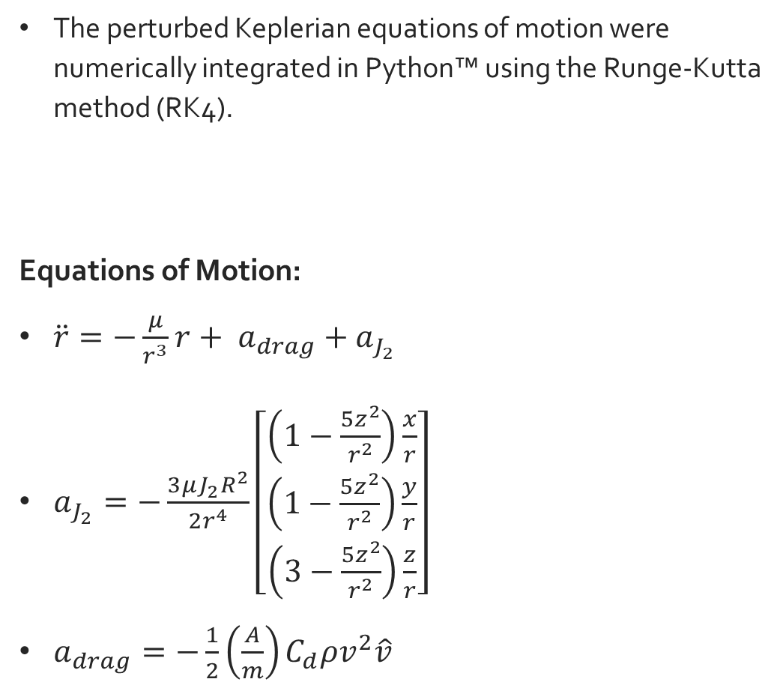
Orbit Propagation using Keplerian Equations of Motion
The perturbed Keplerian equations of motion were numerically integrated in Python™ using the Runge-Kutta method (RK4).
Equations of Motion:
$\ddot{r}=−\frac{μ}{r^{3}}r+ a_{drag}+a_{J_{2}}$
$a_{J_{2}}=−\frac{3μJ_{2}R^{2}}{2r^{4}}\left[\begin{matrix}\left(1−\frac{5z^{2}}{r^{2}}\right)\frac{x}{r} \\ \left(1−\frac{5z^{2}}{r^{2}}\right)\frac{y}{r} \\ \left(3−\frac{5z^{2}}{r^{2}}\right)\frac{z}{r}\end{matrix}\right]$
$a_{drag}=−\frac{1}{2}\left(\frac{A}{m}\right)C_{d}ρv^{2}\hat{v}$

Slide 5
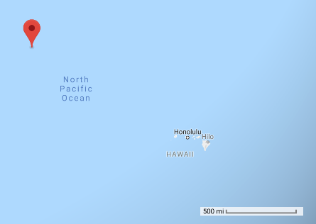
Results: Numerical Integration of Keplerian Equations
Time of a demise: 153 days after the observation epoch or June 14, 2018.
73 day difference from actual re-entry date.
This puts the calculated crash site to be in the North Pacific, about 100 miles northwest of Hawaii.
Final Position (m) | Final Velocity (m/s)
-3762391.12 | 59.76
3577671.24 | -57.18
3704724.90 | -59.06
Calculated Crash Site Location
Latitude | Longitude | Altitude (km)
35.617 | -176.056 | 7186.99

Slide 6
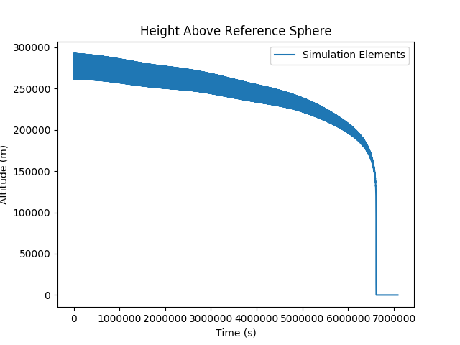
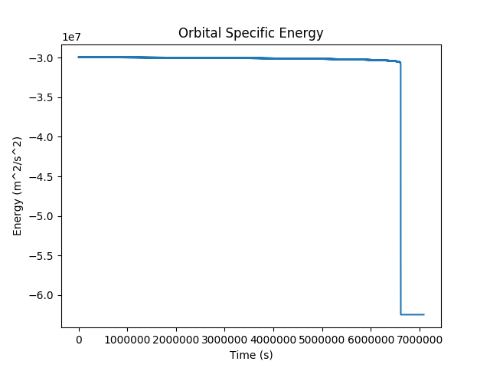
Plots: Numerical Integration
Altitude and Specific Energy decay as expected due to the presence of drag

Slide 7
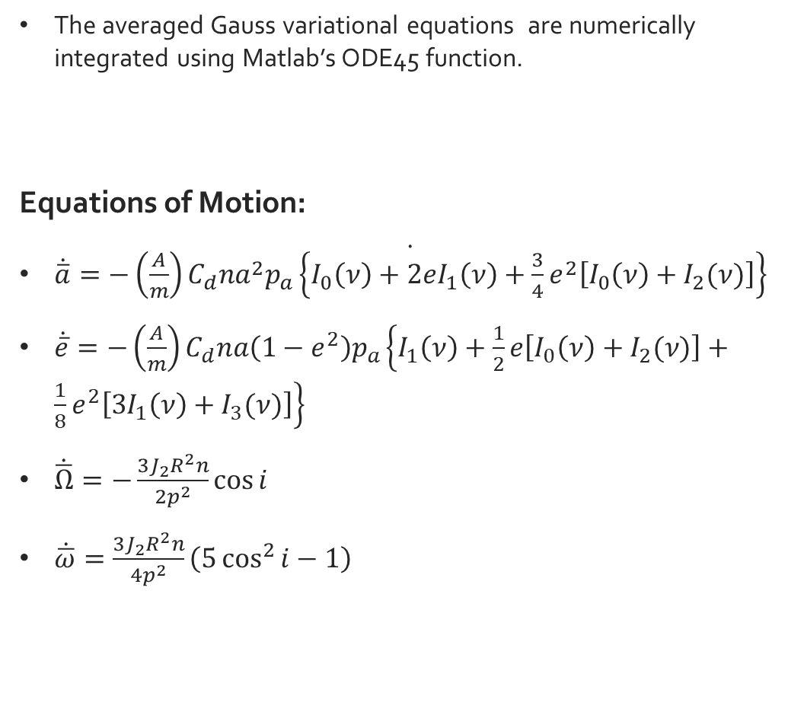
Orbit Propagation using Gauss’ Variational Equations
The averaged Gauss variational equations are numerically integrated using Matlab’s ODE45 function.
Equations of Motion:
$\dot{\dot{\overline{a}}=−\left(\frac{A}{m}\right)C_{d}na^{2}p_{a}\left\{I_{0}\left(ν\right)+2eI_{1}\left(ν\right)+\frac{3}{4}e^{2}\left[I_{0}\left(ν\right)+I_{2}(ν)\right]\right\}}$
$\dot{\overline{e}}=−\left(\frac{A}{m}\right)C_{d}na\left(1−e^{2}\right)p_{a}\left\{I_{1}\left(ν\right)+\frac{1}{2}e\left[I_{0}\left(ν\right)+I_{2}(ν)\right]+\frac{1}{8}e^{2}\left[3I_{1}\left(ν\right)+I_{3}(ν)\right]\right\}$
$\dot{\overline{Ω}}=−\frac{3J_{2}R^{2}n}{2p^{2}}\cos{i}$
$\dot{\overline{ω}}=\frac{3J_{2}R^{2}n}{4p^{2}}\left(5\cos^{2}{i}−1\right)$

Slide 8
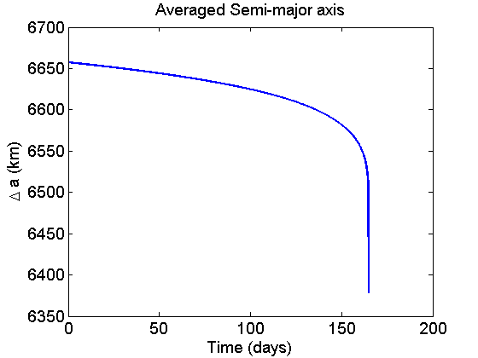
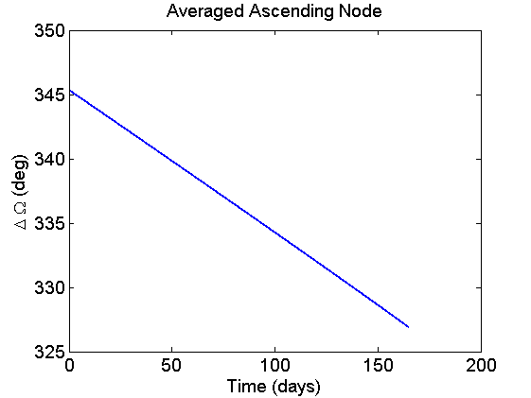
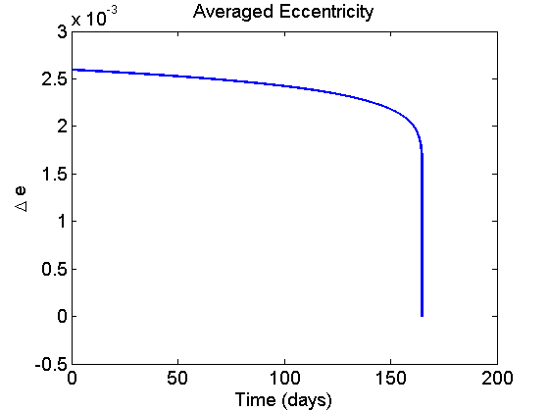
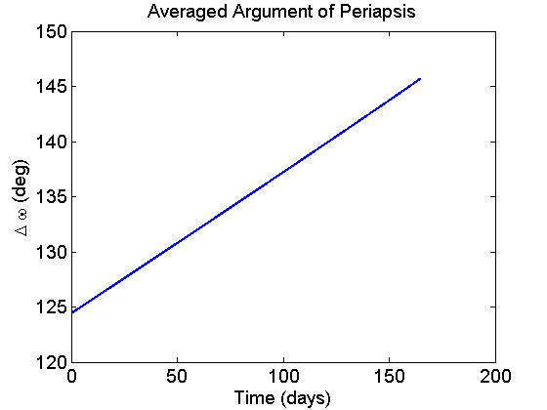
Results: Gauss Variational Equations
Time of a demise: 165 days after the observation epoch or June 27, 2018.
86 day difference from actual re-entry date.

Slide 9
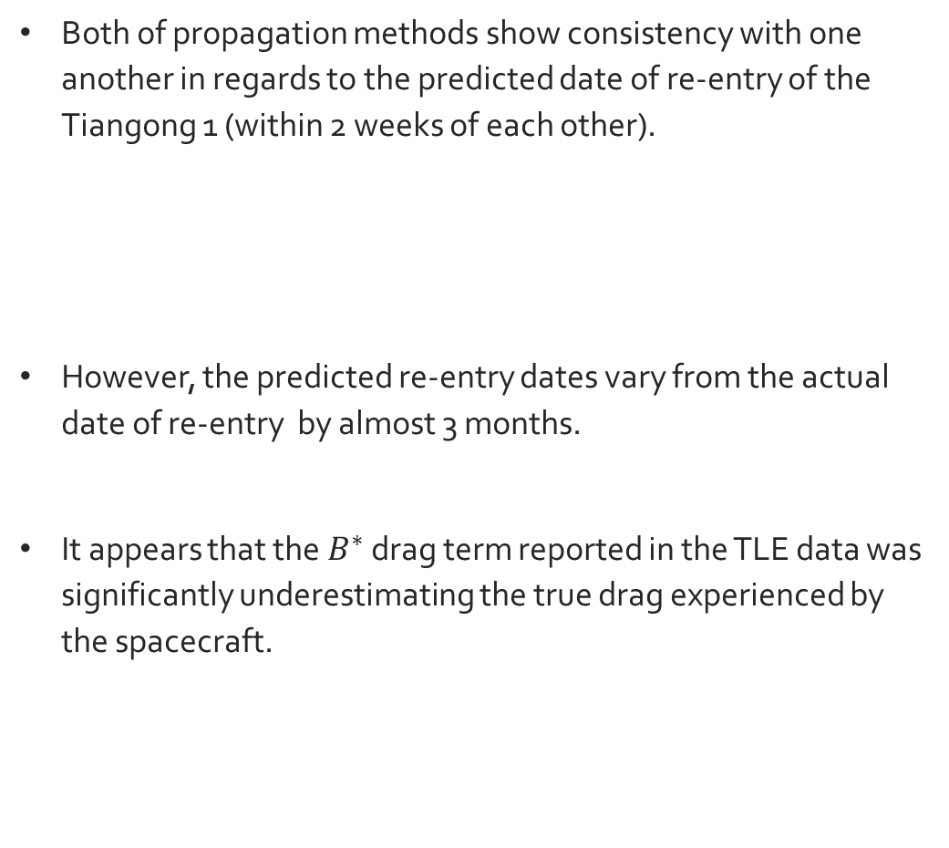
Project Conclusions
Both of propagation methods show consistency with one another in regards to the predicted date of re-entry of the Tiangong 1 (within 2 weeks of each other).
However, the predicted re-entry dates vary from the actual date of re-entry by almost 3 months.
It appears that the $B^{∗}$ drag term reported in the TLE data was significantly underestimating the true drag experienced by the spacecraft.
Propagation Method | Date of Re-entry
Perturbed Keplerian Eqs. | June 14, 2018
Gauss’ Variational Eqs. | June 27, 2018

